Slide 1
Putting Zindi's machine learning community to work on COVID-19
Paul Kennedy

Slide 2
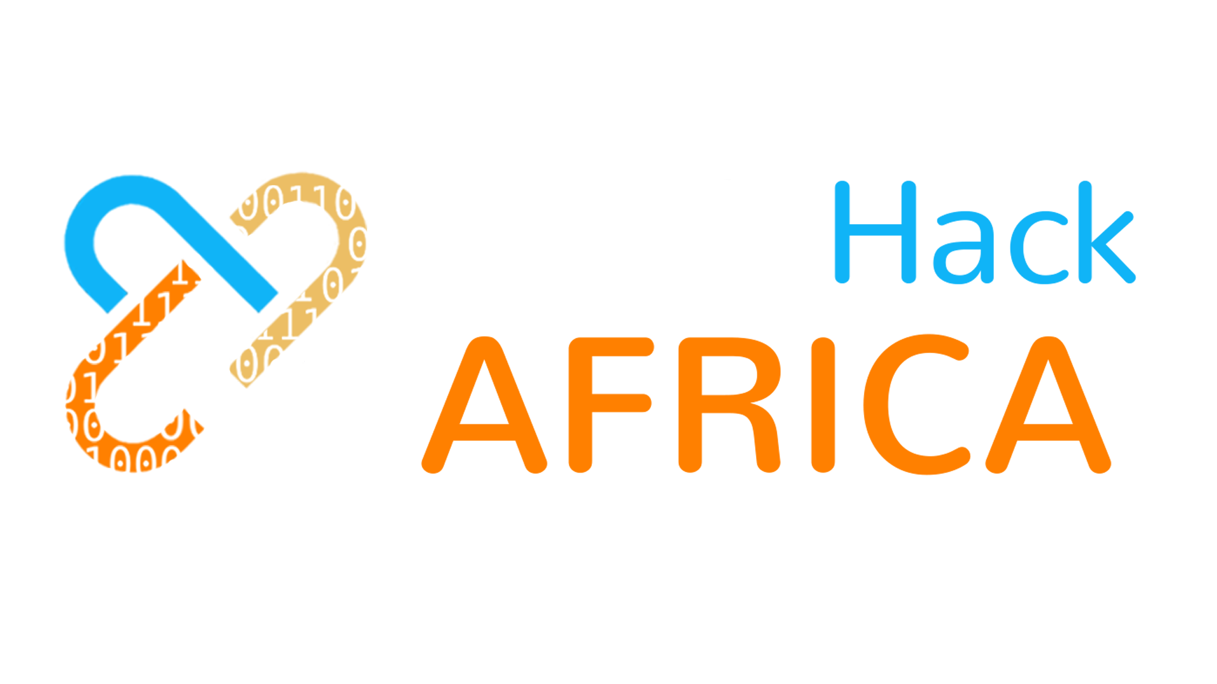
Notes:
I like this picture from our recent UHA – DIY attitude, work and innovation in the face of adversity From UHA, we learned that there is a fantastic appetite for virtual hackathons amongst African data scientists (esp. students

Slide 3
1000+ participants from 15 countries
2500+ machine learning solutions in 7.5 hours
56 universities in 15 African countries
Notes:
The hack drove Zindi users past the 12 000 mark –eager to put their machine learning skills to use solving African problems. When we started this was to be a physical event, but it pivoted seamlessly to be virtual. Immediately saw the potential in this time of remote work. And we had inadvertently already developed a proof-of-concept.

Slide 4
Notes:
For those of you that don’t know Zindi…
Community is here already, they’re skilled and keen. Zindians want to help, but they’re stuck at home. Untapped resource.
So we started thinking about tapping the power of the crowd in a specific way. We do this already, just turn it to a different purpose.

Slide 5
Notes:
So we’ve launched #ZindiWeekendz every Friday – Sunday at Zindi, planning to run for the next 6-8 weeks, depending on data.
Source data where we can, figure out how to make a meaningful challenge, package and get it onto the platform. Opens at Friday noon with a call to action via social channels, closes Sunday midnight.
We have a sponsor that we can’t talk too much about

Slide 6
Week 1: South African COVID-19 Vulnerability Map
Can we infer important COVID-19 public health risk factors from outdated data?
Building an up-to-date map showing where the most vulnerable are located will be a key step in responding to the disease.
Proof-of-concept for how machine learning can help governments more accurately map COVID-19 risk without requiring new data collection

Slide 7
#ZindiWeekendz themes
SA Vulnerability Map (done)
Estimate air quality using satellite imagery
Computer vision to tell if a person in an image wearing a mask
NLP for social listening about COVID-19 using Twitter data
Still looking for mobility and economic impact data

Slide 8
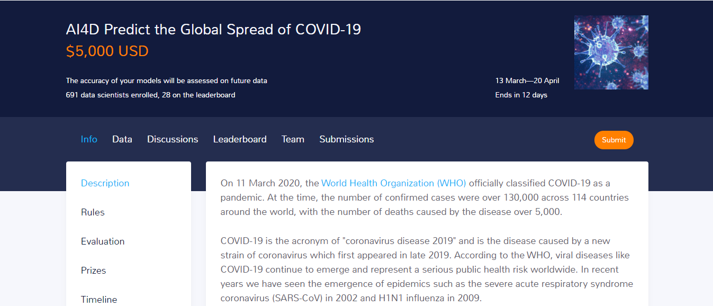
Notes:
Also working in partnership with AI4D to model the global spread of COVID-19. Interesting because this will be tested against data that has not yet been gathered. share their solutions on github april, assess which solutions were the most accurate in June. best solutions will be public, we’ll rerun them on the latest data to predict the spread going forward. We will share all of this publicly. We are in touch with some epidemiologists and we are partnering with AI4D (a non profit) so we will explore how the findings can co tribute to the broader body of knowledge.

Slide 9
What to do with the solutions?
Notes:
These are experiments, cross pollination of approaches and disciplines. Realistically, proofs of concept to show what is possible and start the thinking about new solutions unlocked by AI.
But we are committed to working with partners and supporting those that are working on the issues. Feel strongly about making these useful. So we’re open to ideas. Already one of the participants…

Slide 10
What to do with the solutions?
paul@zindi.africa
Notes:
Feel strongly about making these useful. So we’re open to ideas. Already one of the participants…
Call for help here – if you have good data or you know how we can make these things make a difference, please say so. Get in touch, lets work together

